Slide 1
APPetit
Android food delivery APP
Mobile Application Development
Group 14
Carlo Negri
Davide Gallotti
Federico Gianno
Marco Longo

Slide 2
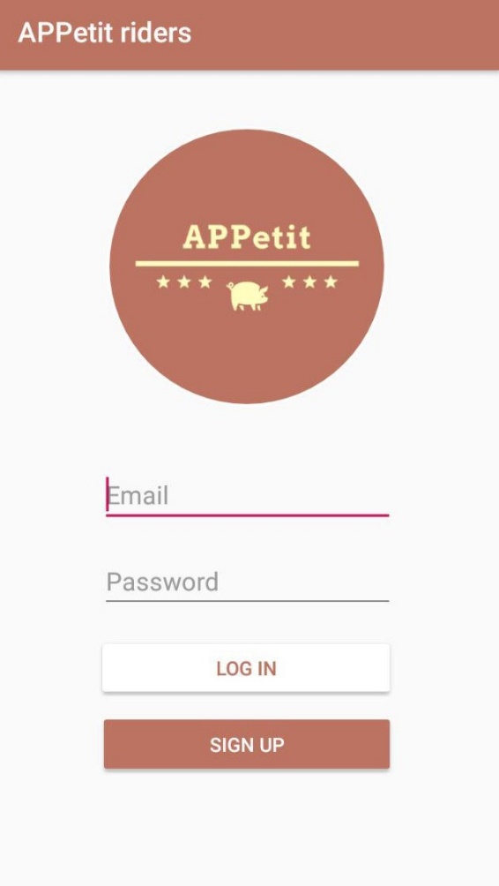
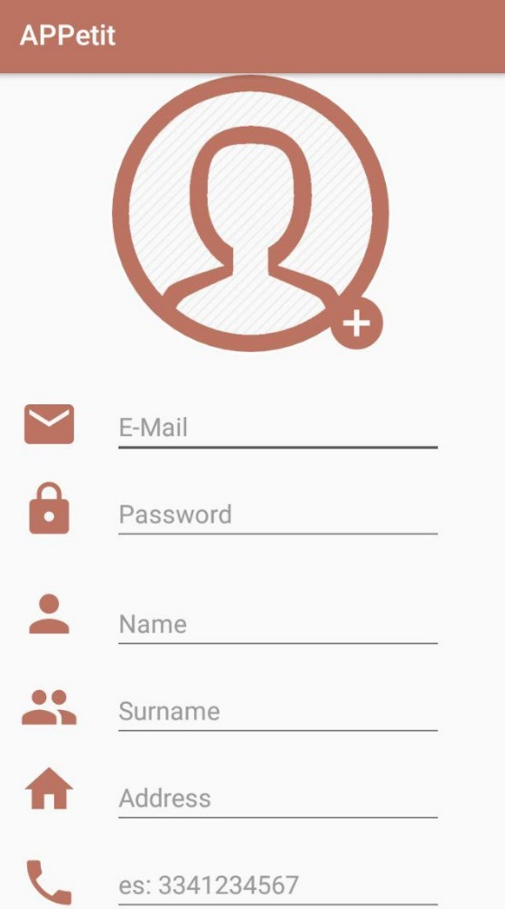
Login and Sign Up
APPetit is an android APP to manage all processes about food delivering.
The app is designed for 3 different kind of users:
Customer
Restaurateur
Riders
Each of them need to sign up by filling the displayed form.
When the confirm button is pressed, the account info are stored into Firebase Authentication Database.

Slide 3
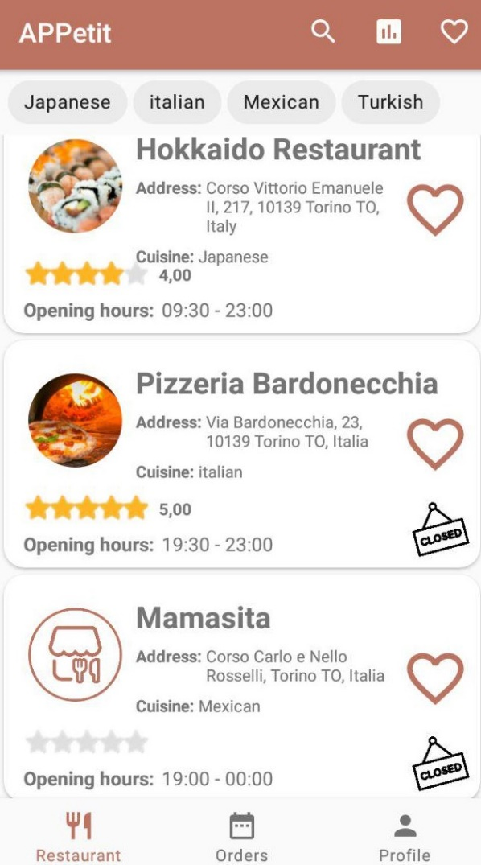
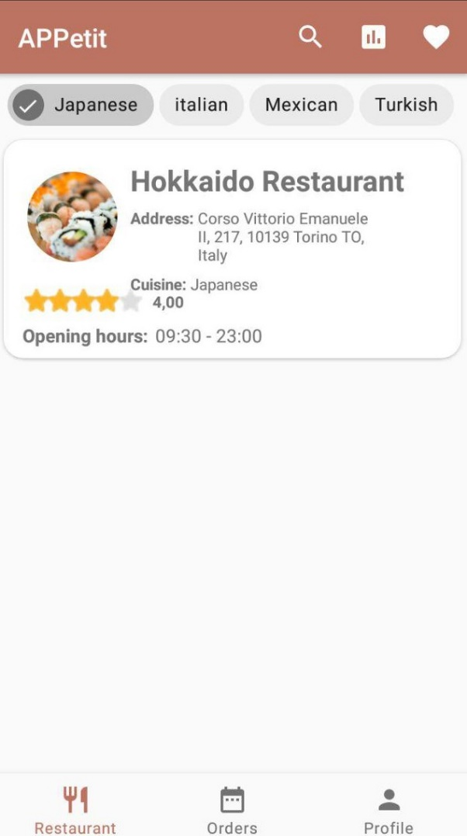
Customer Layout
How it works:
Restaurants list is shown and it is based on the Firebase RecyclerView; Data are retrieved from database by means of a query.
1
2
In order to search a restaurant the user can select different filter criteria based on Favourites Restaurants, Cousine or Review Rank.
3
It is not allowed to order in a closed Restaurant.

Slide 4
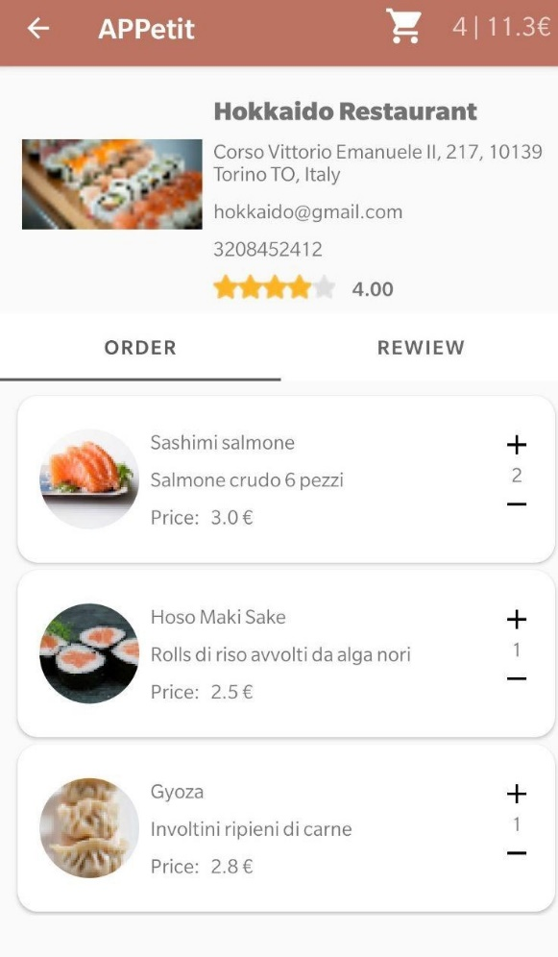
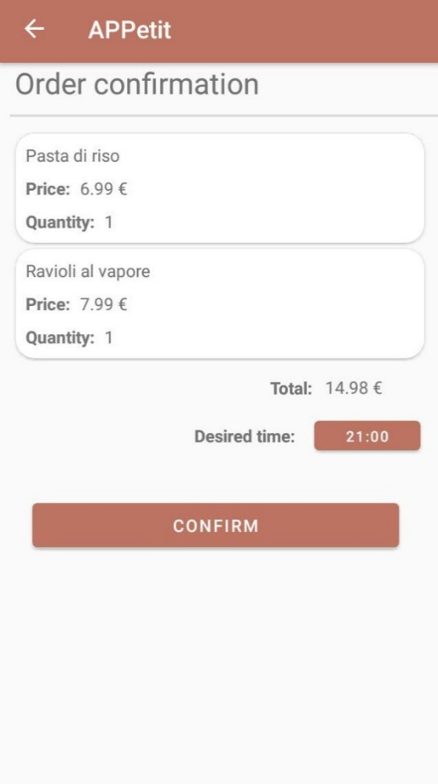
Making an order
Once selected a restaurant, it is possible to view its menu and its reviews.
The user can select the desired quantity of dishes to be ordered and then confirm the order by selecting the desidered delivering time.
The ‘order’ and ‘review’ fragments are managed by a Page Adapter.
Once the order is confirmed, a related data structure is saved into Firebase Database.

Slide 5
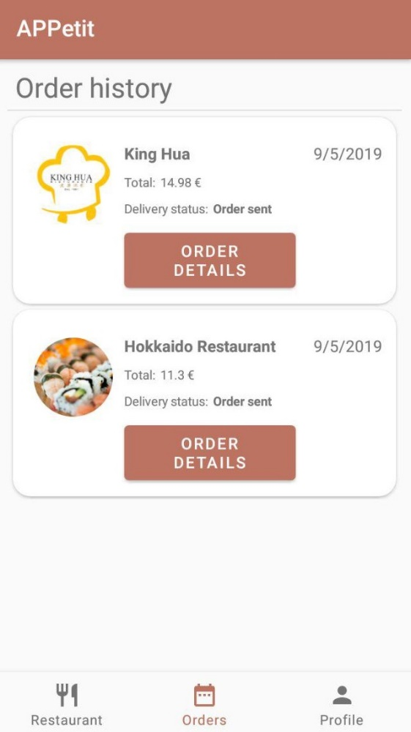
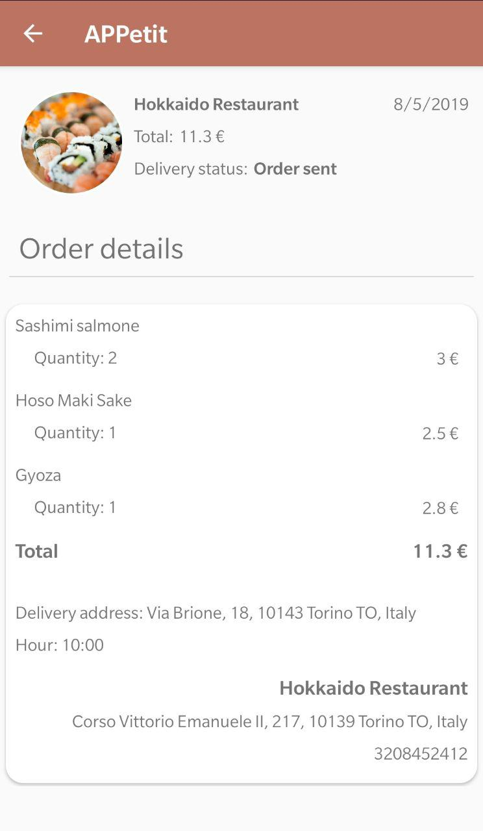
Order History
An order history is available on customer app such that the user can check and review the details of each order including the total price and quantity of dish.
He can also check the current delivering status:
Order Sent
Order Refused
Order Delivering
Order Delivered

Slide 6
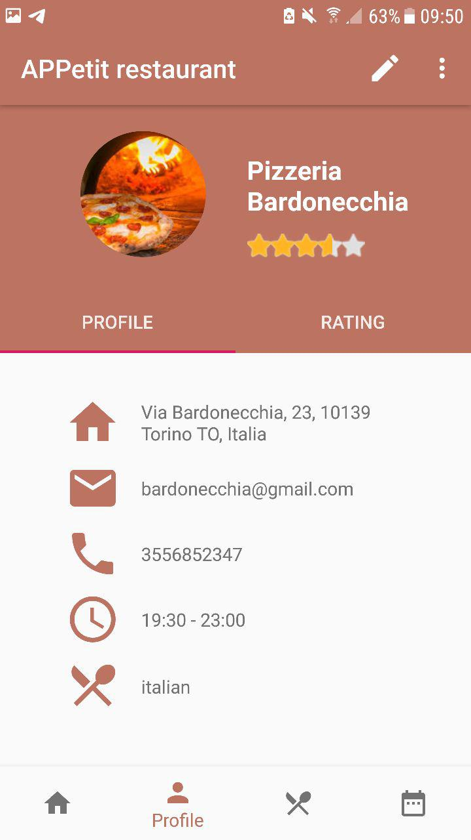
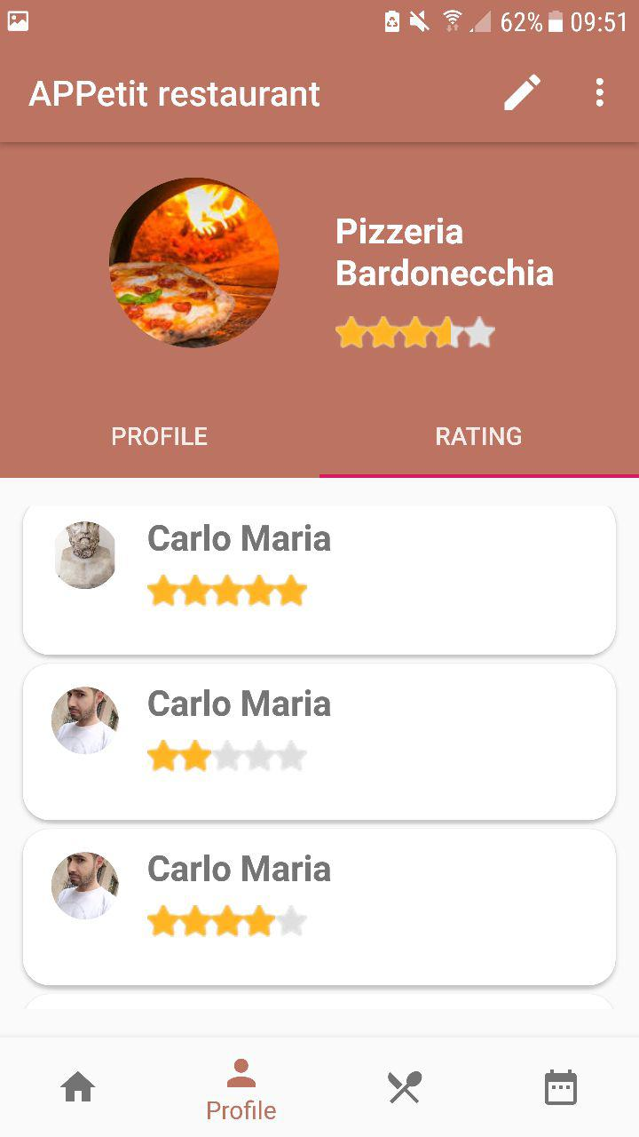
Restaurant Management
The restaurateur profile shows all the information inserted during the registration phase. Data can be modified by clicking on the OptionsMenu.
The Profile Fragment includes also a rating section which includes all the reviews given by users.

Slide 7
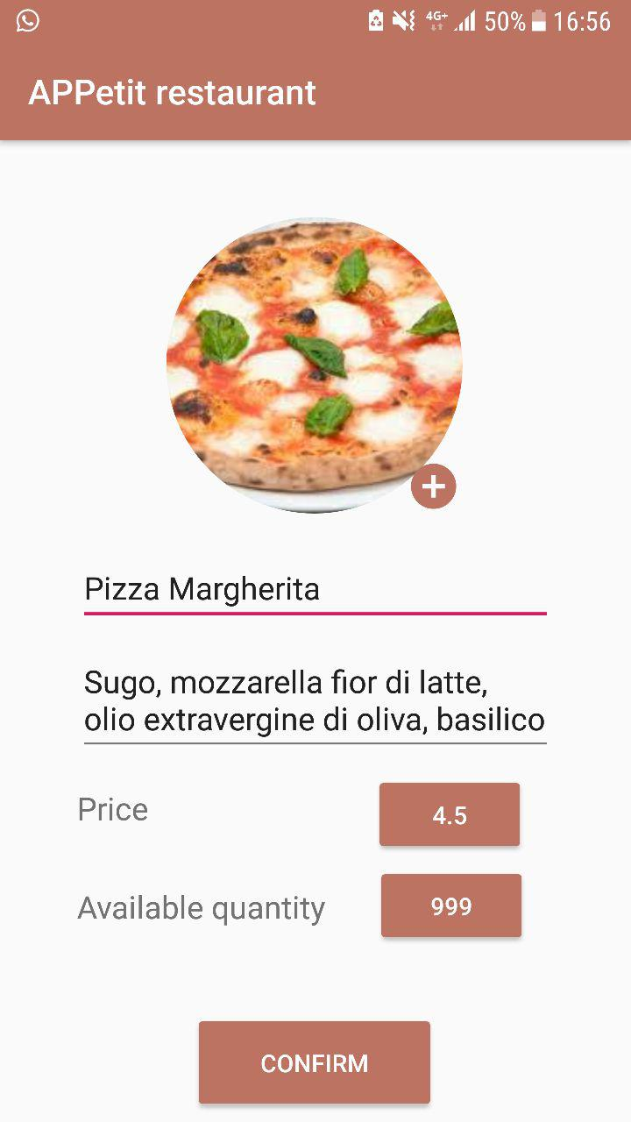
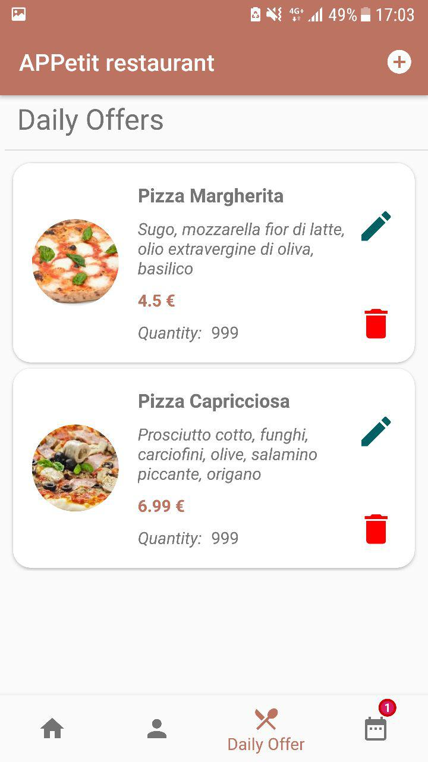
Adding new dish to Daily Offer menu
Restaurateur can add a new dish by filling all the related info. Once the confirm button is pressed the new dish is binded with a ReclyclerView which shows all menu offers.
Every item can be updated or removed from the list through two dedicated buttons.

Slide 8
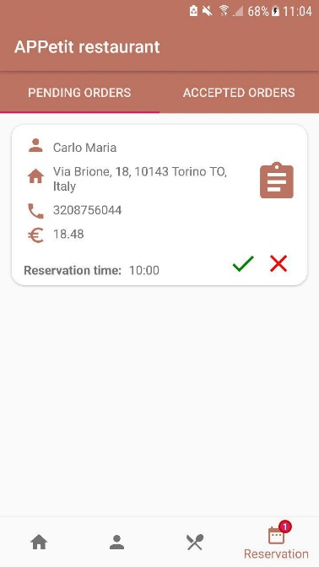
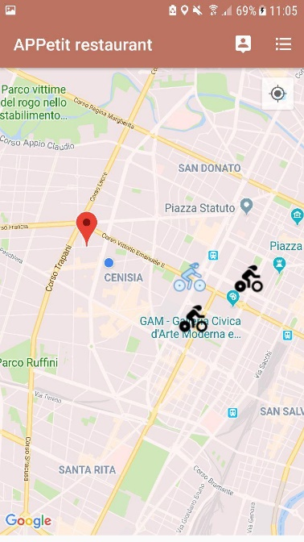
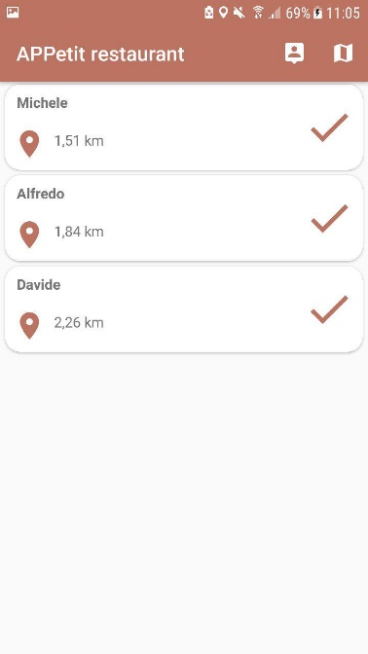
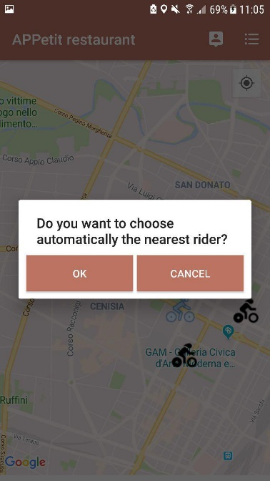
Order Lifecycle
1
Restaurateur receives the order with a related notification on the BottomNavigationMenu
2
The user can select the desidered rider by clicking on him.
3
In alternative way by a list of riders or choosing automatically the nearest one.

Slide 9
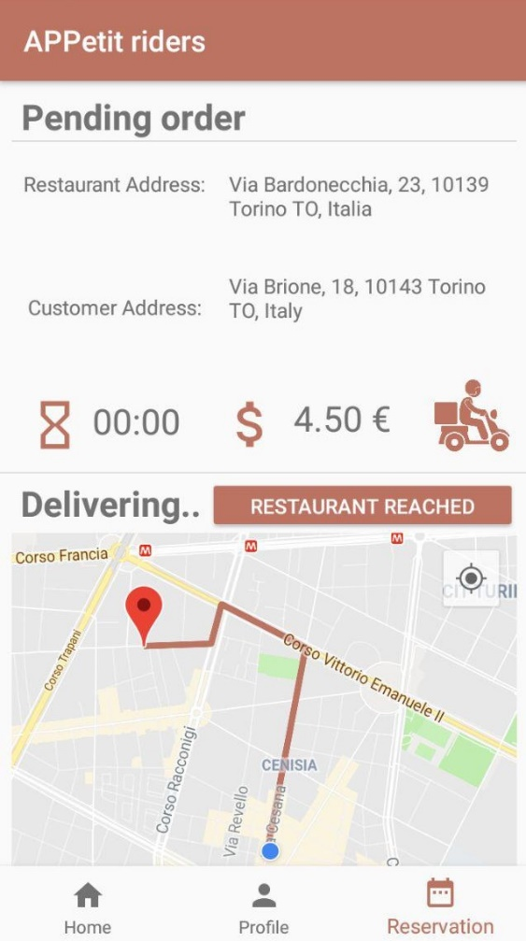
Rider delivering
When an order is assigned to a rider, a notification is shown on his app.
In the Reversation Fragment the rider can see the Restaurant and Customer address.
The path is shown on the map. Moreover, it is updated when the rider reaches the restaurant and the customer’s path is displayed.
When the order is delivered, the rider notifies it by clicking on the related button.

Slide 10
THANKS FOR ATTENTION

